Slide 1

Netflix Dataset Analysis
By,
Umang Mehta
Puneeth Nettekere Rangaswamy
Frank Philip

Slide 2
Overview
Dataset
17770 movies from 1890 to 2005
Dated records consisting of reviews from over 480,000 users
Movies rated on an integer scale 1 to 5
Tasks
Create a recommendation system
Identifying top 5 movies each year
Gauge Opening Strength of a movie

Slide 3
K-Means Clustering for recommendation
Predictions are based on combining clusters using average user rating for particular movie.
Used only 5 clusters for implementing the algorithm as the data has user rating from 1 to 5.
Used a cheap distance m to compute the cluster centers on each iteration.

Slide 4
Top 5 Movies each year
Mapreduce
Compute average rating of each movie
Join this with the movie file to get the movie name
Sort by year and rating and get the top 5 each year
HBase
Drawback: Cannot implement joins
Stored the joined output from previous mapreduce program into Hbase tables
Year+rating+movieID as the key
Hive
Turned out to be easy to implement and the fastest
Except for few setup challenges

Slide 5
Top 5 Movies each year
Comparisions
Mapreduce
3 MapreduceJobs
1st Job : Map-809 Reduce: 25
2nd Job: Map-28 Reduce-1
3rd Job : Map- 1 Reduce:24
Time: 12 minutes
Hive
3 Mapreduce Jobs
1st Job : Map-10 Reduce: 3
2nd Job: Map-2 Reduce-1
3rd Job : Map- 1 Reduce:1
Time: 3 minutes

Slide 6
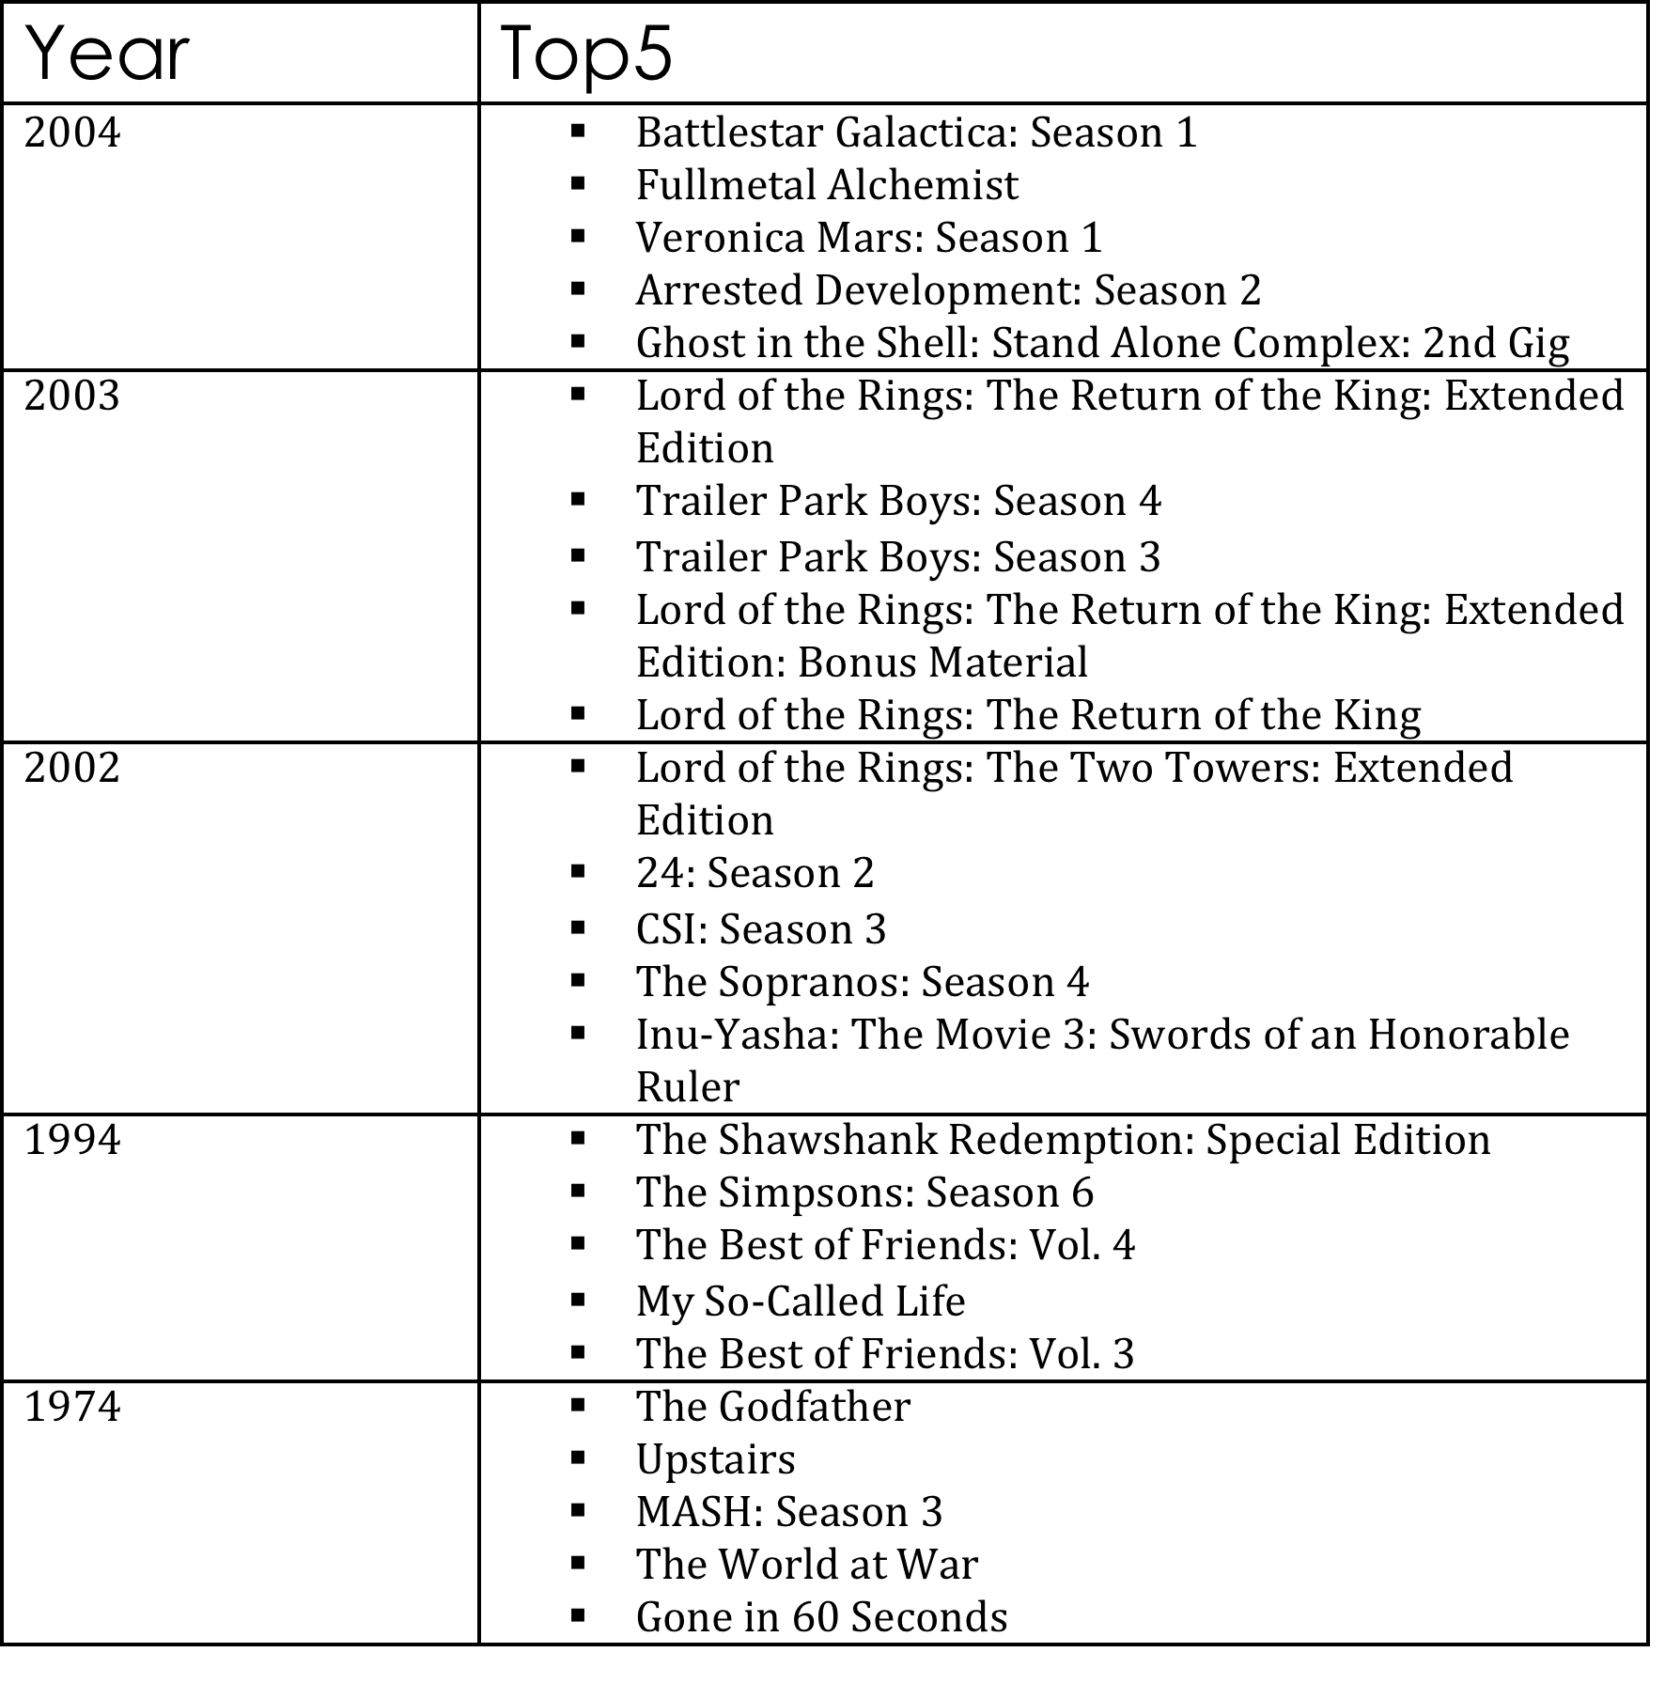
Top 5 Movies each year

Slide 7
Pig Latin Schematic Data Flow
Load Review Records
Sort by Movie ID and Review Date ascending
Group by Movie ID
For each movie ID generate launch date
Join by Movie ID
Filter by review date 30 days from launch date
Group by Movie ID
For each movie ID generate count(record)
Load Movie Records
Join by Movie ID
For each movie ID generate movie title, opening strength

Slide 8
HBase Implementation Overview
Row ID = Movie ID + Review Date + User ID
Compute operation input limited to first 30 records for each movie ID
Reducer task in compute, calculates the opening strength of the movie
Additional MapReduce job to perform join operation to obtain movie title

Slide 9
Pig Latin v/s HBase
Populate time: Nil
Compute time: 17 min
Scalable for larger input
Small code footprint
Populate time: 1 hour 30 min
Compute time: 4 min
Populate bottleneck prevents scalability
Larger code footprint

Slide 10
Thank you.

